Slide 1

EXIM BANK SECTORAL PERFORMANCE
MARCH 2024
Prepared by:
Strategic Planning Department
29 Mar 2024

Slide 2
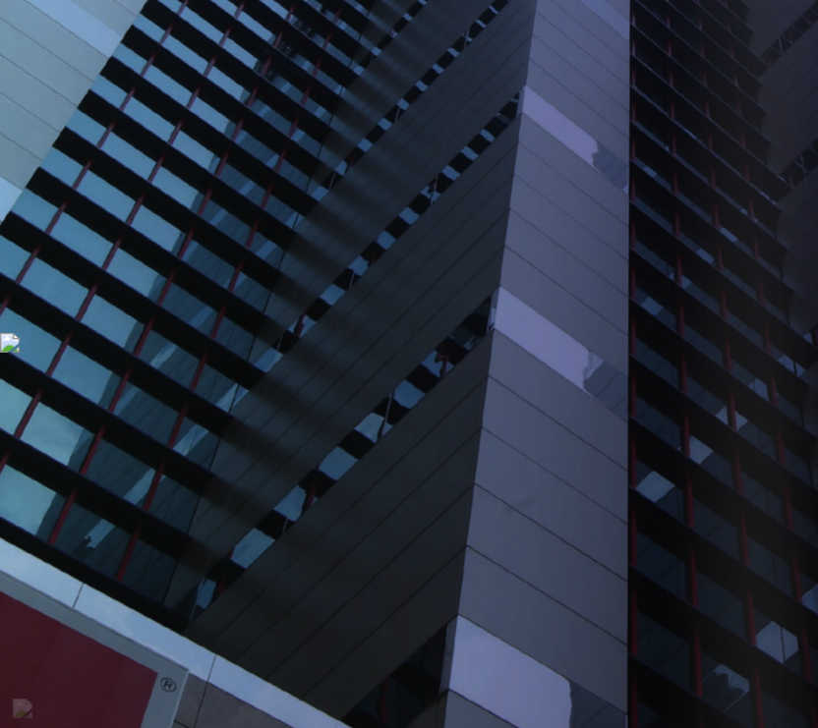
1
Quarterly Performance
Agenda
2
Projected Asset
3
Appendix (Top 15 New Prospect)

Slide 3
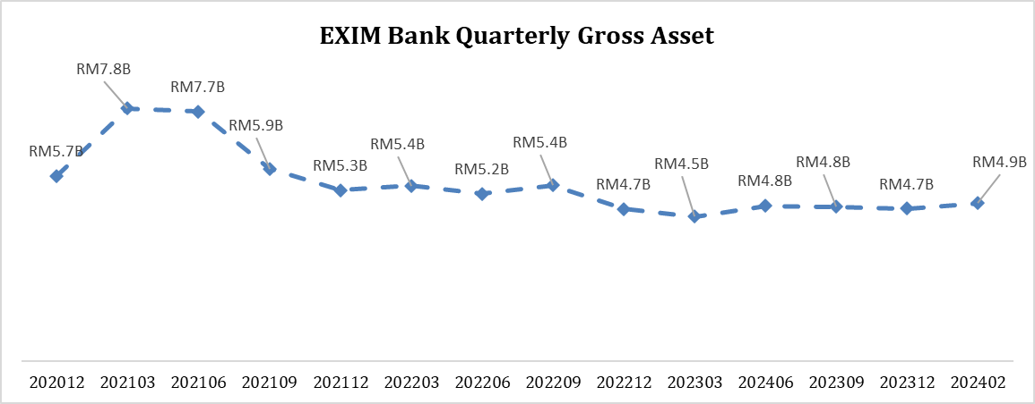
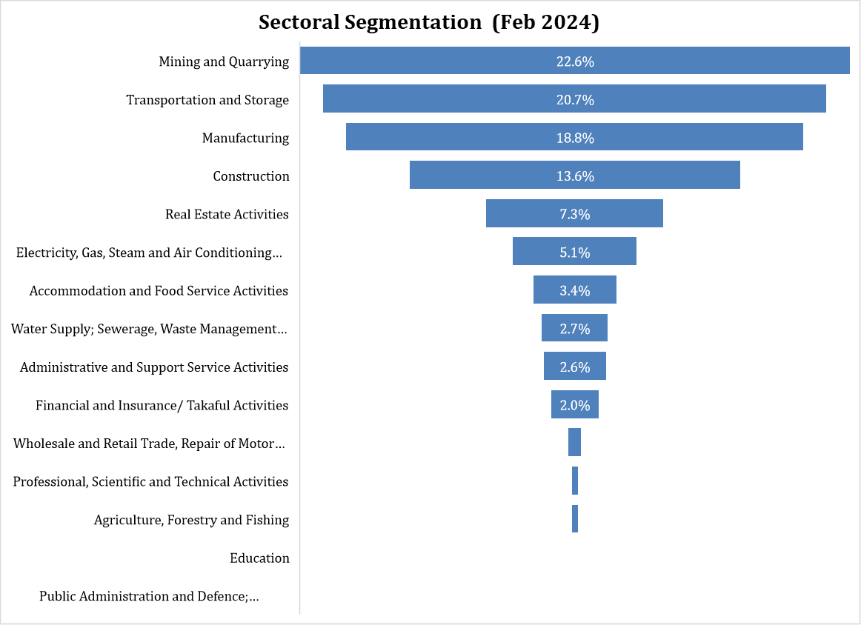
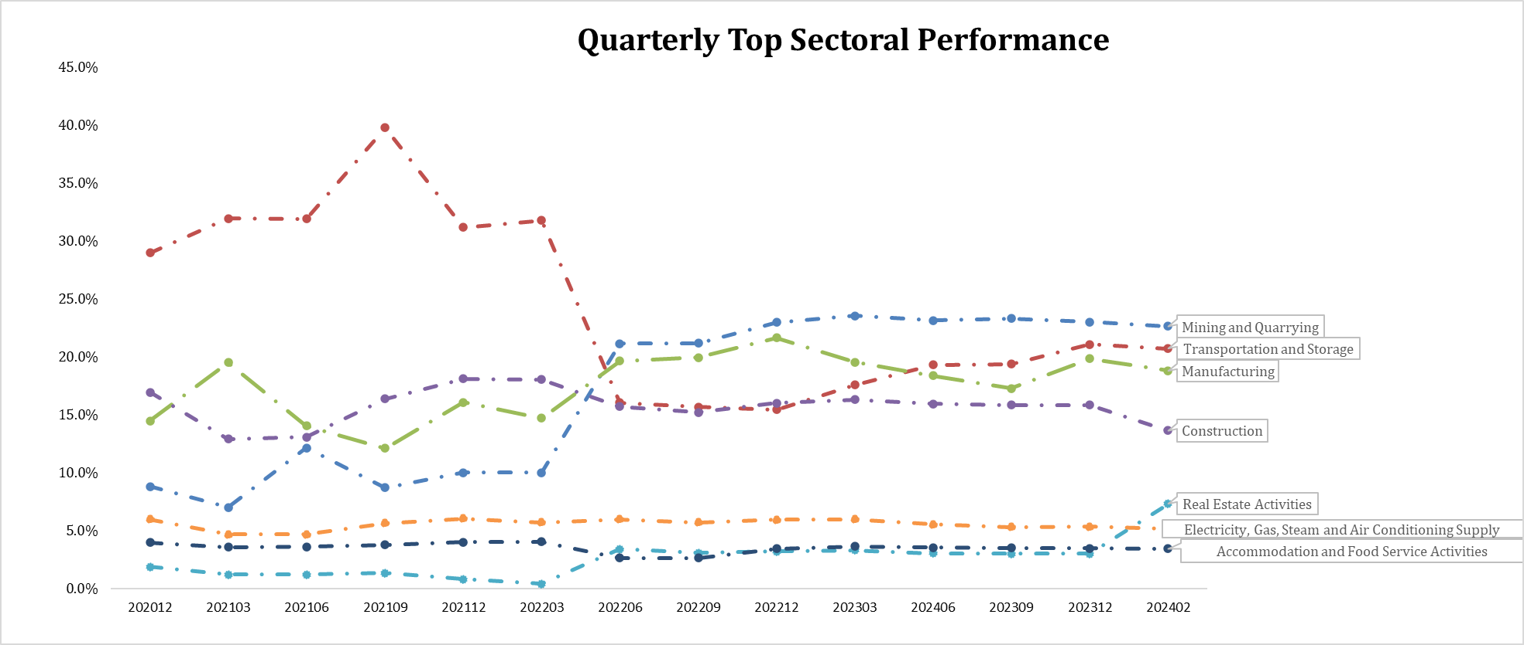
Quarterly Performance
The performance below shows the asset started to decline in Jun 2021 and steadily decreases up to Feb 2024 mostly due transportation & storage sector. As of Feb 2024, most of our asset comes from mining and quarrying that has steadily grow since Jun 2022. Some sector has already settled such as education and public admin since Sep 2021 and Jun 2022 respectively and newly emerging sector is water supply since Jun 2022.

Slide 4
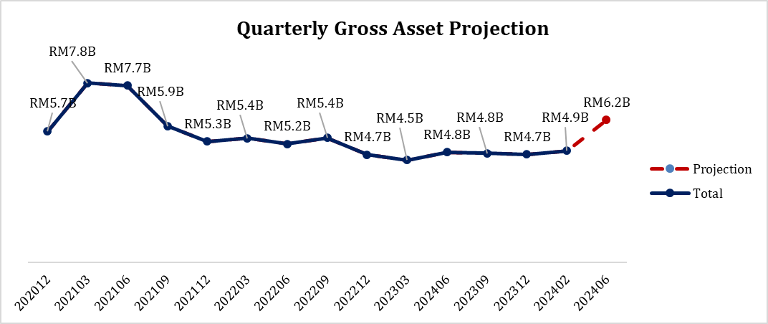
Projected Asset
The projection shows EXIM Bank can grow up to 27.33% for the next following quarter by RM1.3 billion @ 51 Accounts. The new emerging sector is human health and most sector that is rapidly grow are manufacturing, transportation and construction.
Sector | Total Cust | Total Acc | Amount Approved (MYR) | Total Loans Outstanding (MYR) | Paid Ratio (Interest+Principal) | Pending Customer | Pending Accounts | Pending Facility Limit (MYR) | Expected Grow Against Current Asset
Manufacturing | 31 | 45 | 1,630,731,055.82 | 914,002,427.15 | 43.95% | 18 | 22 | 602,194,750.00 | 65.89%
Transportation and Storage | 19 | 26 | 1,911,768,942.26 | 1,006,619,092.42 | 47.35% | 3 | 4 | 47,425,000.00 | 4.71%
Construction | 13 | 18 | 1,232,302,362.15 | 662,177,507.64 | 46.27% | 4 | 7 | 372,477,000.00 | 56.25%
Wholesale and Retail Trade, Repair of Motor Vehicles and Motorcycles | 8 | 13 | 152,280,969.40 | 25,956,182.08 | 82.96% | 5 | 5 | 81,525,000.00 | 314.09%
Accommodation and Food Service Activities | 6 | 8 | 209,697,625.00 | 167,448,766.57 | 20.15% | 1 | 2 | 4,640,850.00 | 2.77%
Mining and Quarrying | 6 | 9 | 1,502,570,662.50 | 1,099,759,088.34 | 26.81% | 0 | 0 | - | 0.00%
Real Estate Activities | 5 | 5 | 538,856,763.85 | 355,215,726.39 | 34.08% | 1 | 1 | 95,910,900.00 | 27.00%
Administrative and Support Service Activities | 3 | 3 | 533,050,241.30 | 125,251,987.51 | 76.50% | 0 | 0 | - | 0.00%
Electricity, Gas, Steam and Air Conditioning Supply | 3 | 6 | 376,725,000.00 | 248,989,449.40 | 33.91% | 3 | 3 | 87,712,500.00 | 35.23%
Professional, Scientific and Technical Activities | 3 | 3 | 27,980,250.00 | 13,743,009.90 | 50.88% | 3 | 7 | 34,703,125.00 | 252.51%
Water Supply; Sewerage, Waste Management and Remediation Activities | 2 | 2 | 170,525,997.00 | 132,935,590.34 | 22.04% | 0 | 0 | - | 0.00%
Agriculture, Forestry and Fishing | 1 | 1 | 12,974,325.00 | 13,273,019.49 | 0.00% | 0 | 0 | - | 0.00%
Financial and Insurance/ Takaful Activities | 1 | 1 | 95,050,000.00 | 96,440,403.93 | 0.00% | 0 | 0 | - | 0.00%
Human Health and Social Work Activities | 0 | 0 | - | - | 0.00% | 1 | 1 | 2,000,000.00 | New
Total | 101 | 140 | 8,394,514,194.29 | 4,861,812,251.17 | 57.92% | 38 | 51 | 1,328,589,125.00 | 27.33%

Slide 5
Appendix (Top 15 New Prospect)
Below shows the top 15 new prospect contributed to the 27.33% growth from current asset. 55.45% from the expected growth comes from non-bumi companies in manufacturing and construction sector invested in Malaysia and Japan.
Customer Name | Nature of Account | Facility | Country Exposure | Sector | Bumi Status | Corporate Size | Facility Limit (MYR) | Composition
Kian Joo Cans Distribution Sdn Bhd | Non Trade | Term Financing - i | Malaysia | Manufacture of other fabricated metal products n.e.c. | Non-Bumi | Non-SME | 250,000,000.00 | 18.82%
BERJAYA CONSTRUCTION BERHAD | Non Trade | Contract Financing Overseas | Japan | Construction of other civil engineering projects | Non-Bumi | Non-SME | 237,625,000.00 | 17.89%
SARAWAK MEDICAL INNOVATION & TECHNOLOGY HUB SDN. BHD. | Non Trade | Term Financing - i | Malaysia | Manufacture of medical and dental instruments and supplies | Non-Bumi | Non-SME | 139,000,000.00 | 10.46%
URBAN PINNACLE SDN. BHD. | Non Trade | Term Financing - i | Malaysia | Construction of buildings n.e.c. | Non-Bumi | Non-SME | 110,000,000.00 | 8.28%
JLAND Australia Pty Ltd | Non Trade | Overseas Project Financing - i | Australia | Activities of real estate agents and brokers for buying, selling and renting of real estate | Bumi | Non-SME | 95,910,900.00 | 7.22%
Pertama Ferroalloys Sdn. Bhd. | Trade | Letter of Credit/Trust Receipt | Malaysia | Manufacture of other basic precious and other non-ferrous metals n.e.c. | Non-Bumi | Non-SME | 95,050,000.00 | 7.15%
UZMA KUALA MUDA SDN. BHD | Non Trade | Term Financing - i | Malaysia | Electric power generation, transmission and distribution (including renewable energy) | Bumi | Non-SME | 62,400,000.00 | 4.70%
BOUSTEAD PETROLEUM MARKETING SDN BHD | Trade | Supplier Financing - i | Malaysia | Other retail trade, except of motor vehicles and motorcycles | Bumi | Non-SME | 47,525,000.00 | 3.58%
PWN Excellence Sdn Bhd | Non Trade | Term Financing - i | Malaysia | Service activities incidental to air transportation | Bumi | SME-Medium | 30,225,000.00 | 2.27%
FABULOUS SUNVIEW SDN BHD | Non Trade | Import Financing - i | Malaysia | Electric power generation, transmission and distribution (including renewable energy) | Non-Bumi | Non-SME | 23,762,500.00 | 1.79%
INGRESS INDUSTRIAL (MALAYSIA) SDN BHD | Trade | Supplier Financing - i | Indonesia | Manufacture of other fabricated metal products n.e.c. | Bumi | Non-SME | 19,010,000.00 | 1.43%
SMH RAIL INDIA SDN BHD | Non Trade | Contract Financing Overseas- i | India | Manufacture of railway locomotives and rolling stock | Non-Bumi | Non-SME | 19,010,000.00 | 1.43%
Hernan Corporation Sdn Bhd | Trade | Letter of Credit/Trust Receipt-i | Malaysia | Manufacture of other food products | Non-Bumi | SME-Medium | 18,534,750.00 | 1.40%
Tiong Nam Logistics Solutions Sdn. Bhd. | Non Trade | Term Financing - i | Malaysia | Warehousing and storage | Non-Bumi | Non-SME | 15,200,000.00 | 1.14%
SARAWAK MEDICAL INNOVATION & TECHNOLOGY HUB SDN. BHD. | Trade | Supplier Financing - i | Malaysia | Manufacture of medical and dental instruments and supplies | Non-Bumi | Non-SME | 15,000,000.00 | 1.13%

Slide 6
Thank You

